Slide 1
Payroll Protection Program Loan Forgiveness Application Timm Johnson, Mason SBDC

Slide 2
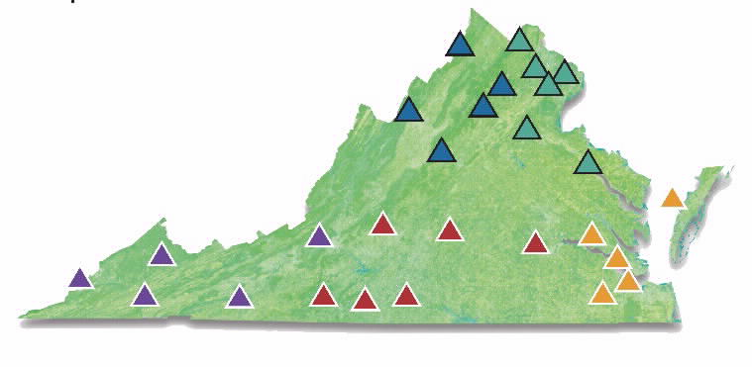
Virginia Small Business Development Center (SBDC) Network
https://www.virginiasbdc.org/locations/
Notes:
Key services of SBDC are counseling, training and information resources
60% of clients are existing firms—gradual shift in past 3 years
50% are women
14% are veterans
26% are minority firms
Areas of counseling and training – financing, marketing, business/strategic planning, start-up
Services (professional, IT, contractors), Retail
Track activities---numbers of companies assiste, but more importantly we ask clients to tell us the results of their SBDC engagement---Jobs created/retained, sales growth, new capital (Debt and equity) and for pre-ventures—did you start a business.

Slide 3
PPP Flexible Forgiveness Act
Forgiveness Application Overview
Schedule Completion & Safe Harbor Tests
Application Completion
https://www.virginiasbdc.org/recoveryresourcecenter//

Slide 4
PPP Forgiveness Forms
https://www.virginiasbdc.org/business-recovery-center/ppp-loan-forgiveness-explained/

Slide 5
PPP Flexibility Act
Act was signed into law by the President on June 5, 2020.
“Covered period” from 8-weeks to 24-weeks, but not beyond December 31, 2020
75/25 payroll/non-payroll cost minimum requirement to 60% payroll and 40% non-payroll.
If using the 24 Week period – Salaries paid maximum increases to $46,154. Owners Pay is capped at $20,833
Form 3508EZ created to simplify Forgiveness

Slide 6
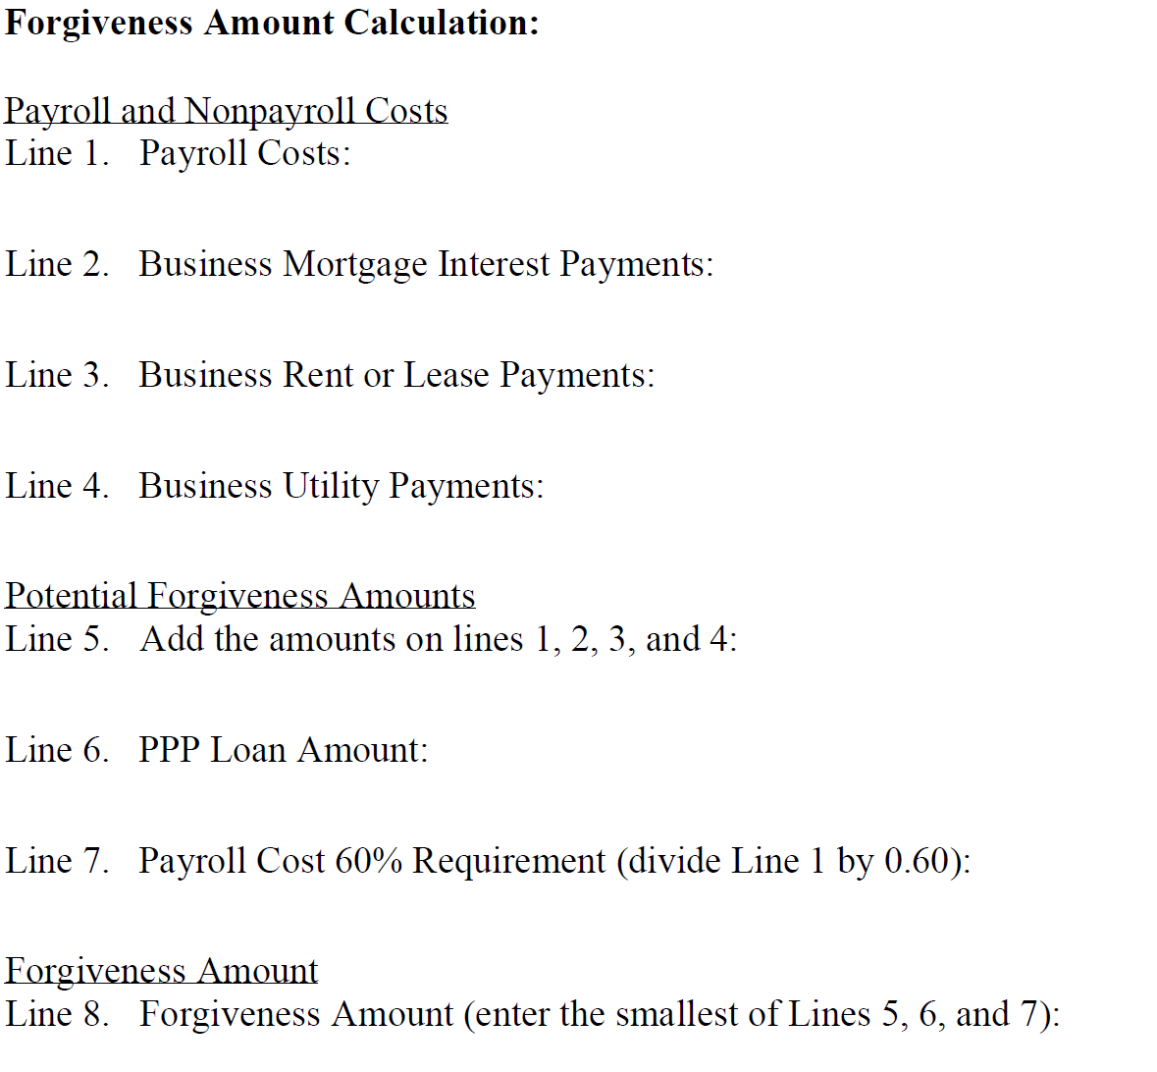
Form 3508 EZ Eligibility Requirements
Sole Proprietor, Independent Contractor or Self Employed with NO employees
Did not reduce the number of employees or the average full-time employee paid hours or wages below 25% between January 1, 2020 and the end of the Covered Period.
No penalty if business required to reduce or shut down, Employees refused to return or unable to replace employees
Tests look at Jan 1 to March 31 and February 15 as comparison periods

Slide 7
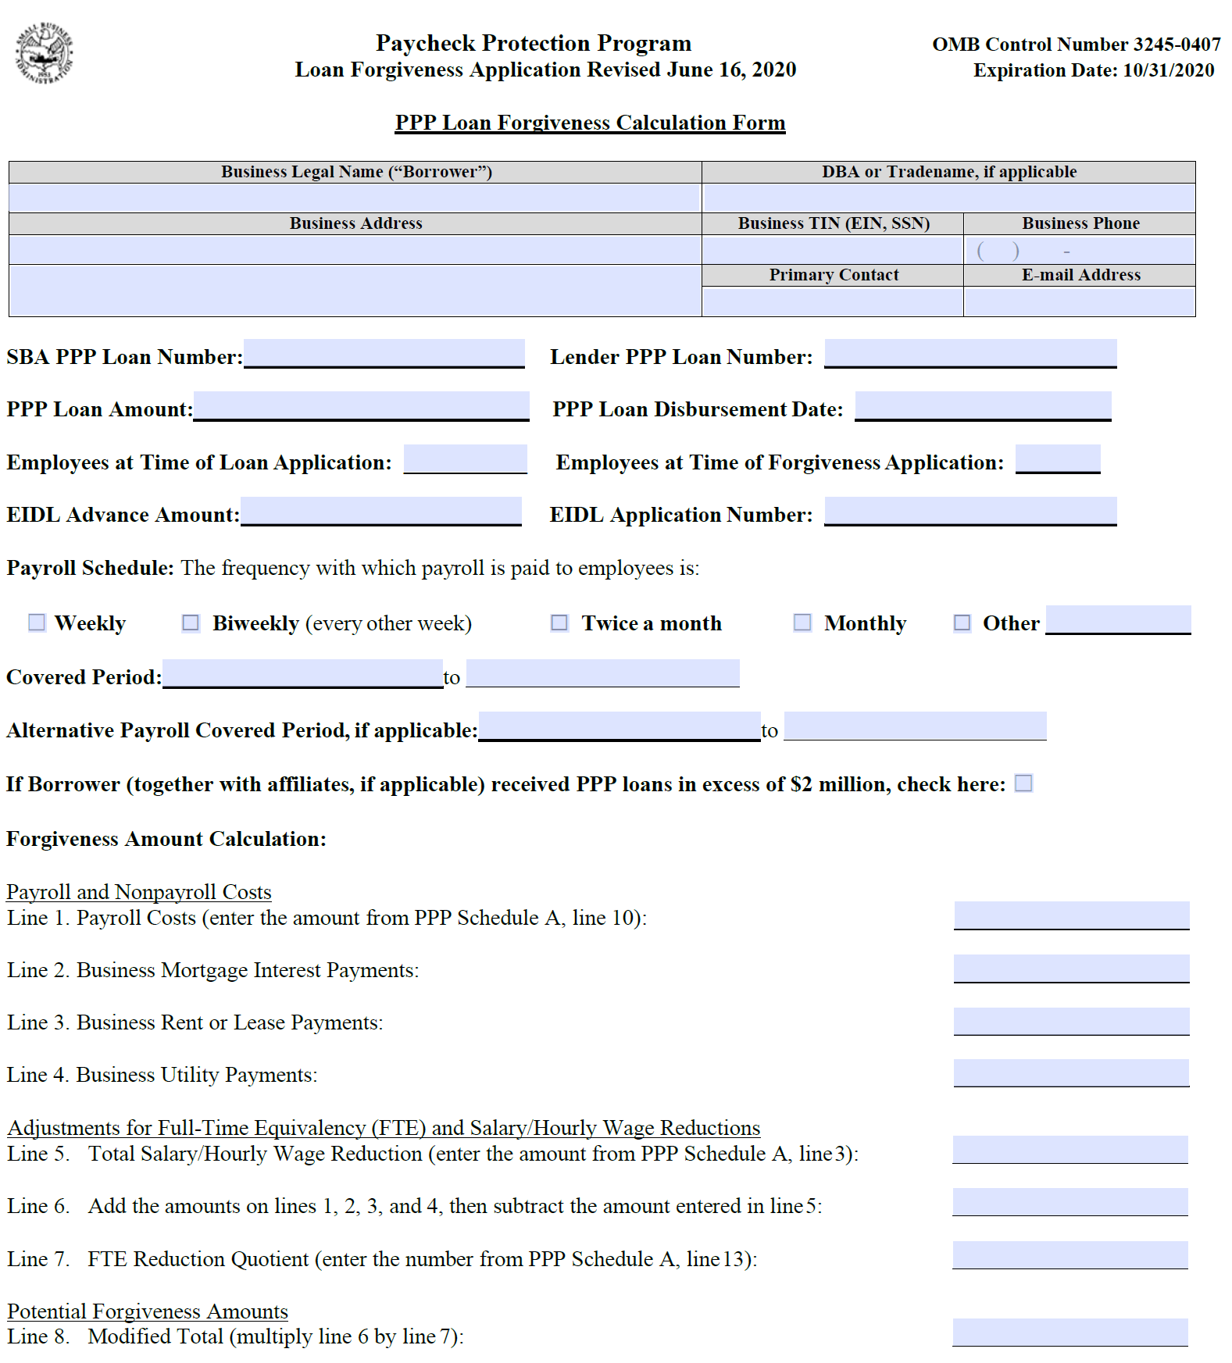
PPP Form 3508 Long Form Application Breakdown
PPP Application Page 1 requires company information. Page 2 shows certifications and signature line
Calculates the Forgiveness Amount based on input from Schedule A
PPP Schedule A (Page 3) – Calculates Payroll Costs portion of Forgiveness
PPP Schedule A Worksheet (Page 4) – Cash Compensation paid for each employee
Table 1 for Employees earning under $100,000 annually
FTE Determination
Salary Reduction Determination

Slide 8
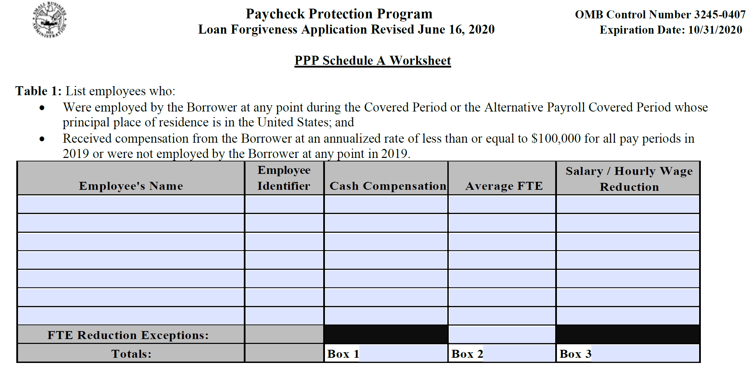

Slide 9
PPP Schedule A Worksheet Tables 1 and 2
Gross paid salaries during 24 Week Period for EACH Employee – Match your Payroll Register
FTE (Full Time Equivalent) Calculation for the coverage for each employee based on 40 hour week
Enter 1 for a full time employee
For part-time employees – average weekly hours worked / 40 Hours (30 Hours/40 hour = .75)
Alternative method - .5 for part-time
Salary/Hourly Wage Reduction Calculation Total for EACH Employee based on Safe Harbor Tests (page 4 test lines)
Gather payroll registers for the Covered 24 week period AND Comparison Period

Slide 10
FTE and Salary Reduction Determination
Test Questions Begin on Page 4 – to be applied to each employee
FTE Impact – Comparing FTE during Coverage vs Comparison Period
Must use same Calculation Method for both periods
Comparison period for FTEs between February 15 – April 26, As of February 15 AND Forgiven date submission
Reduction % value calculates on Schedule A – Line 13
Salary/Hourly Wage Payment Reduction – 75% test for EACH employee
Compares Annualized Salary for Covered Period vs Jan 1 – Mar 31 2020
If below 75%, then Steps 2 though 3 use Annualized Salary at Feb 15, Feb 15 to April 26 and June 30.
Reduction calculation based on % below 75% applied to the 24 week period
Ready to move to Schedule A

Slide 11
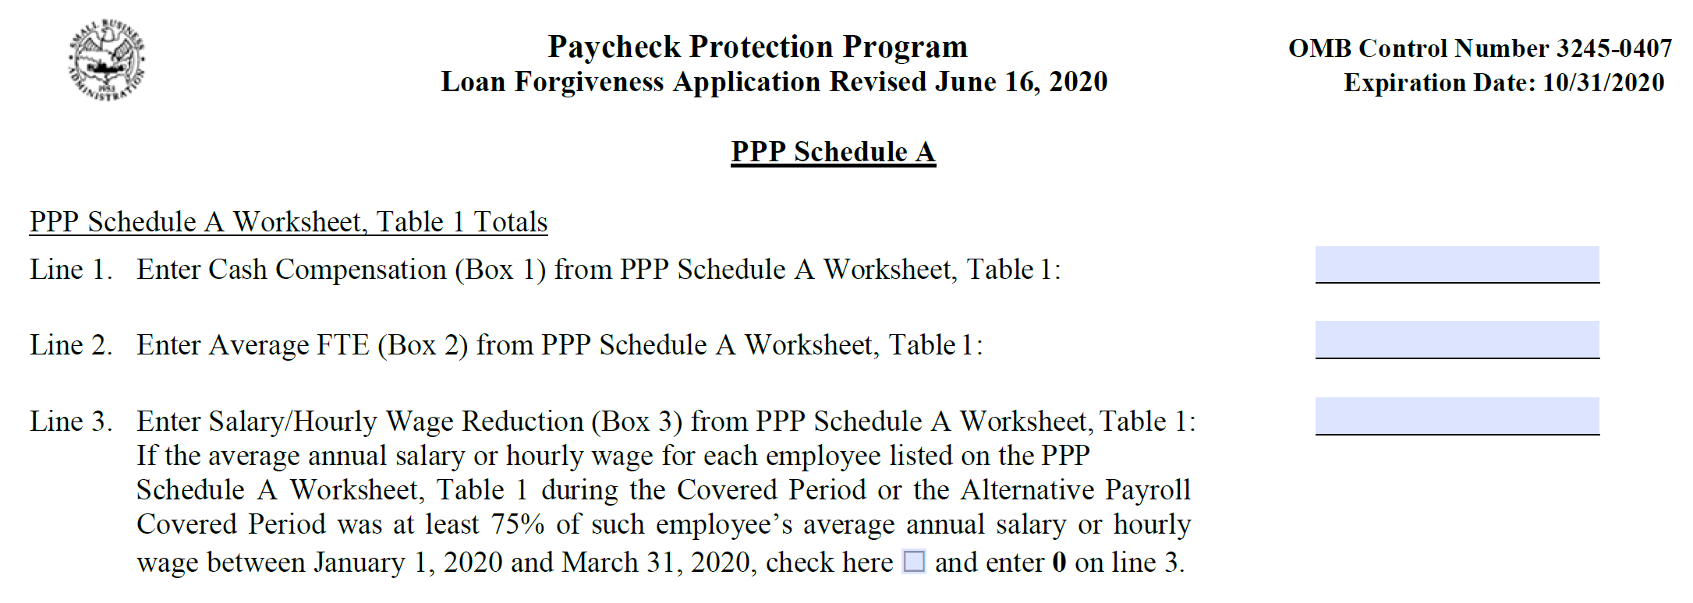

Slide 12
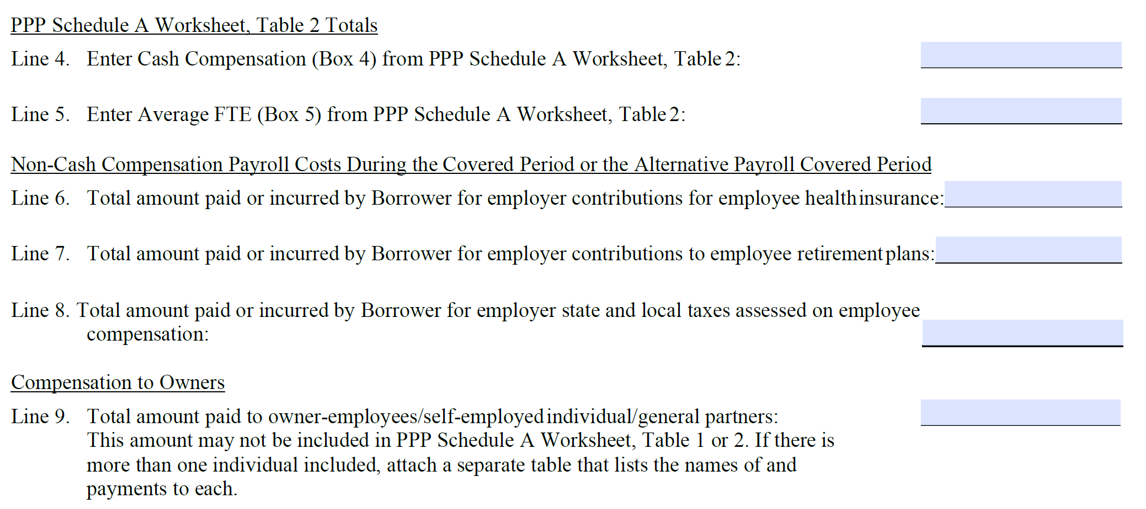

Slide 13
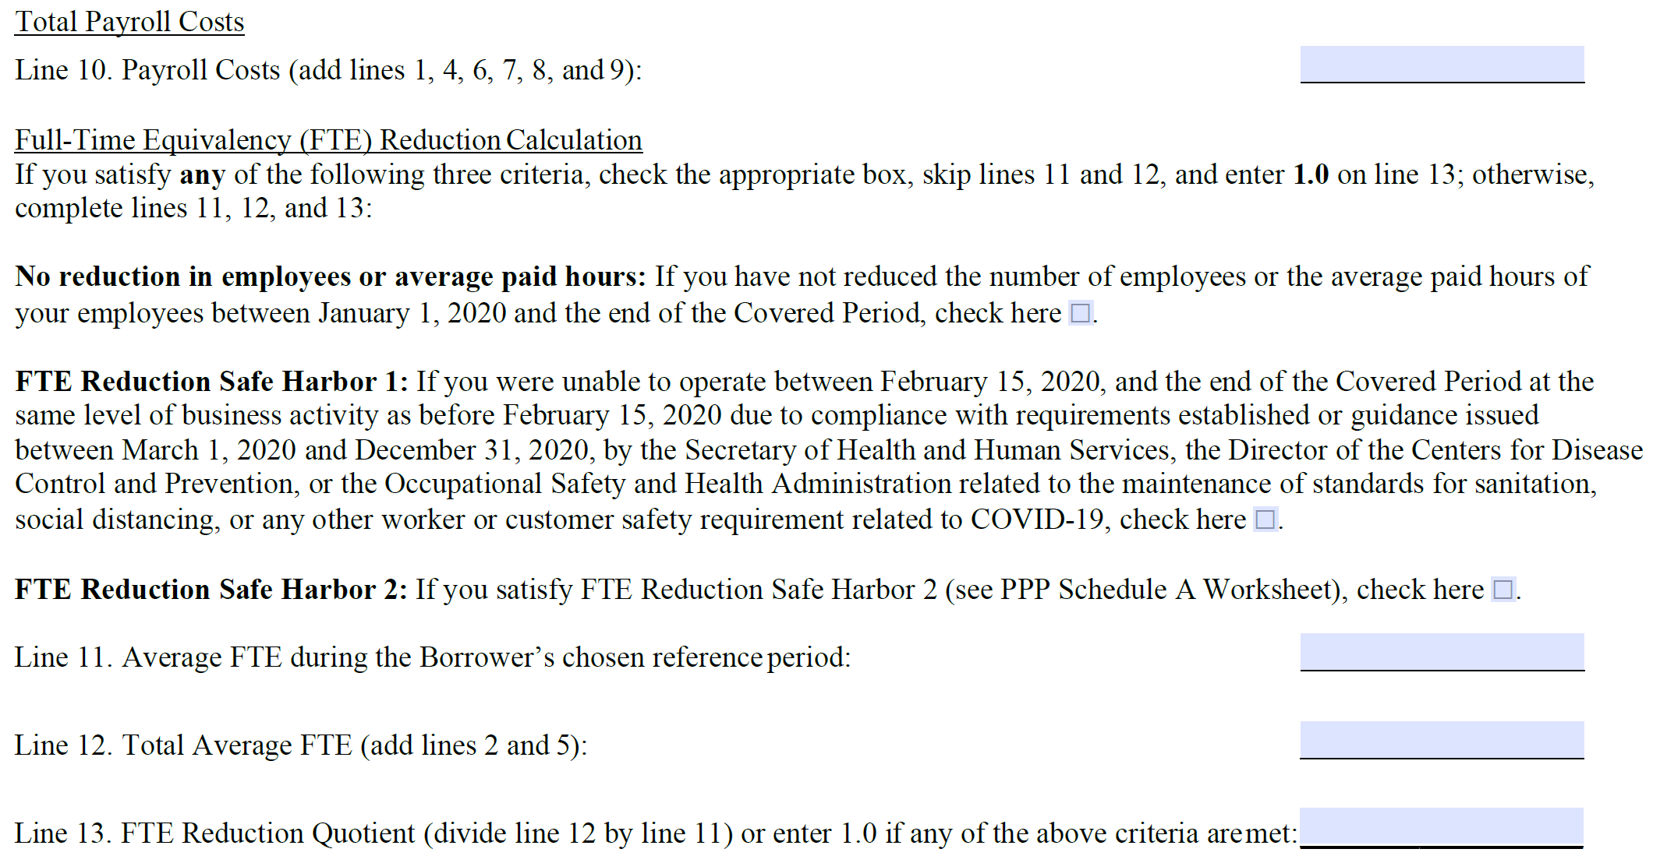
On completion of Schedule A, Move to the PPP Application – Page 1

Slide 14
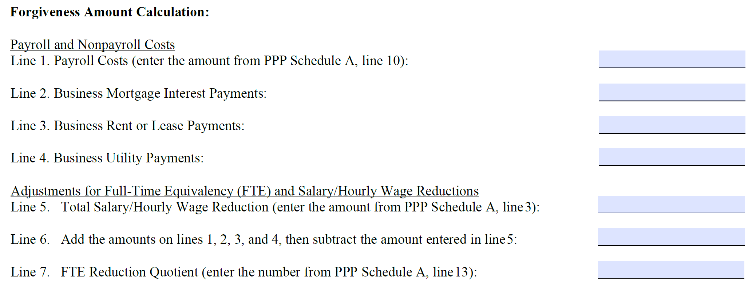
Forgiveness Application Page 1

Slide 15
Forgiveness Application Page 1
Line 11: Enter the smallest of lines 8, 9, or 10. Note: If applicable, SBA will deduct EIDL Advance Amounts from the forgiveness amount remitted to the Lender
Signature and Initials follow on page 2
Your lender will provide the list for supporting documentation
Use the SBDC Spreadsheet to do the math

Slide 16
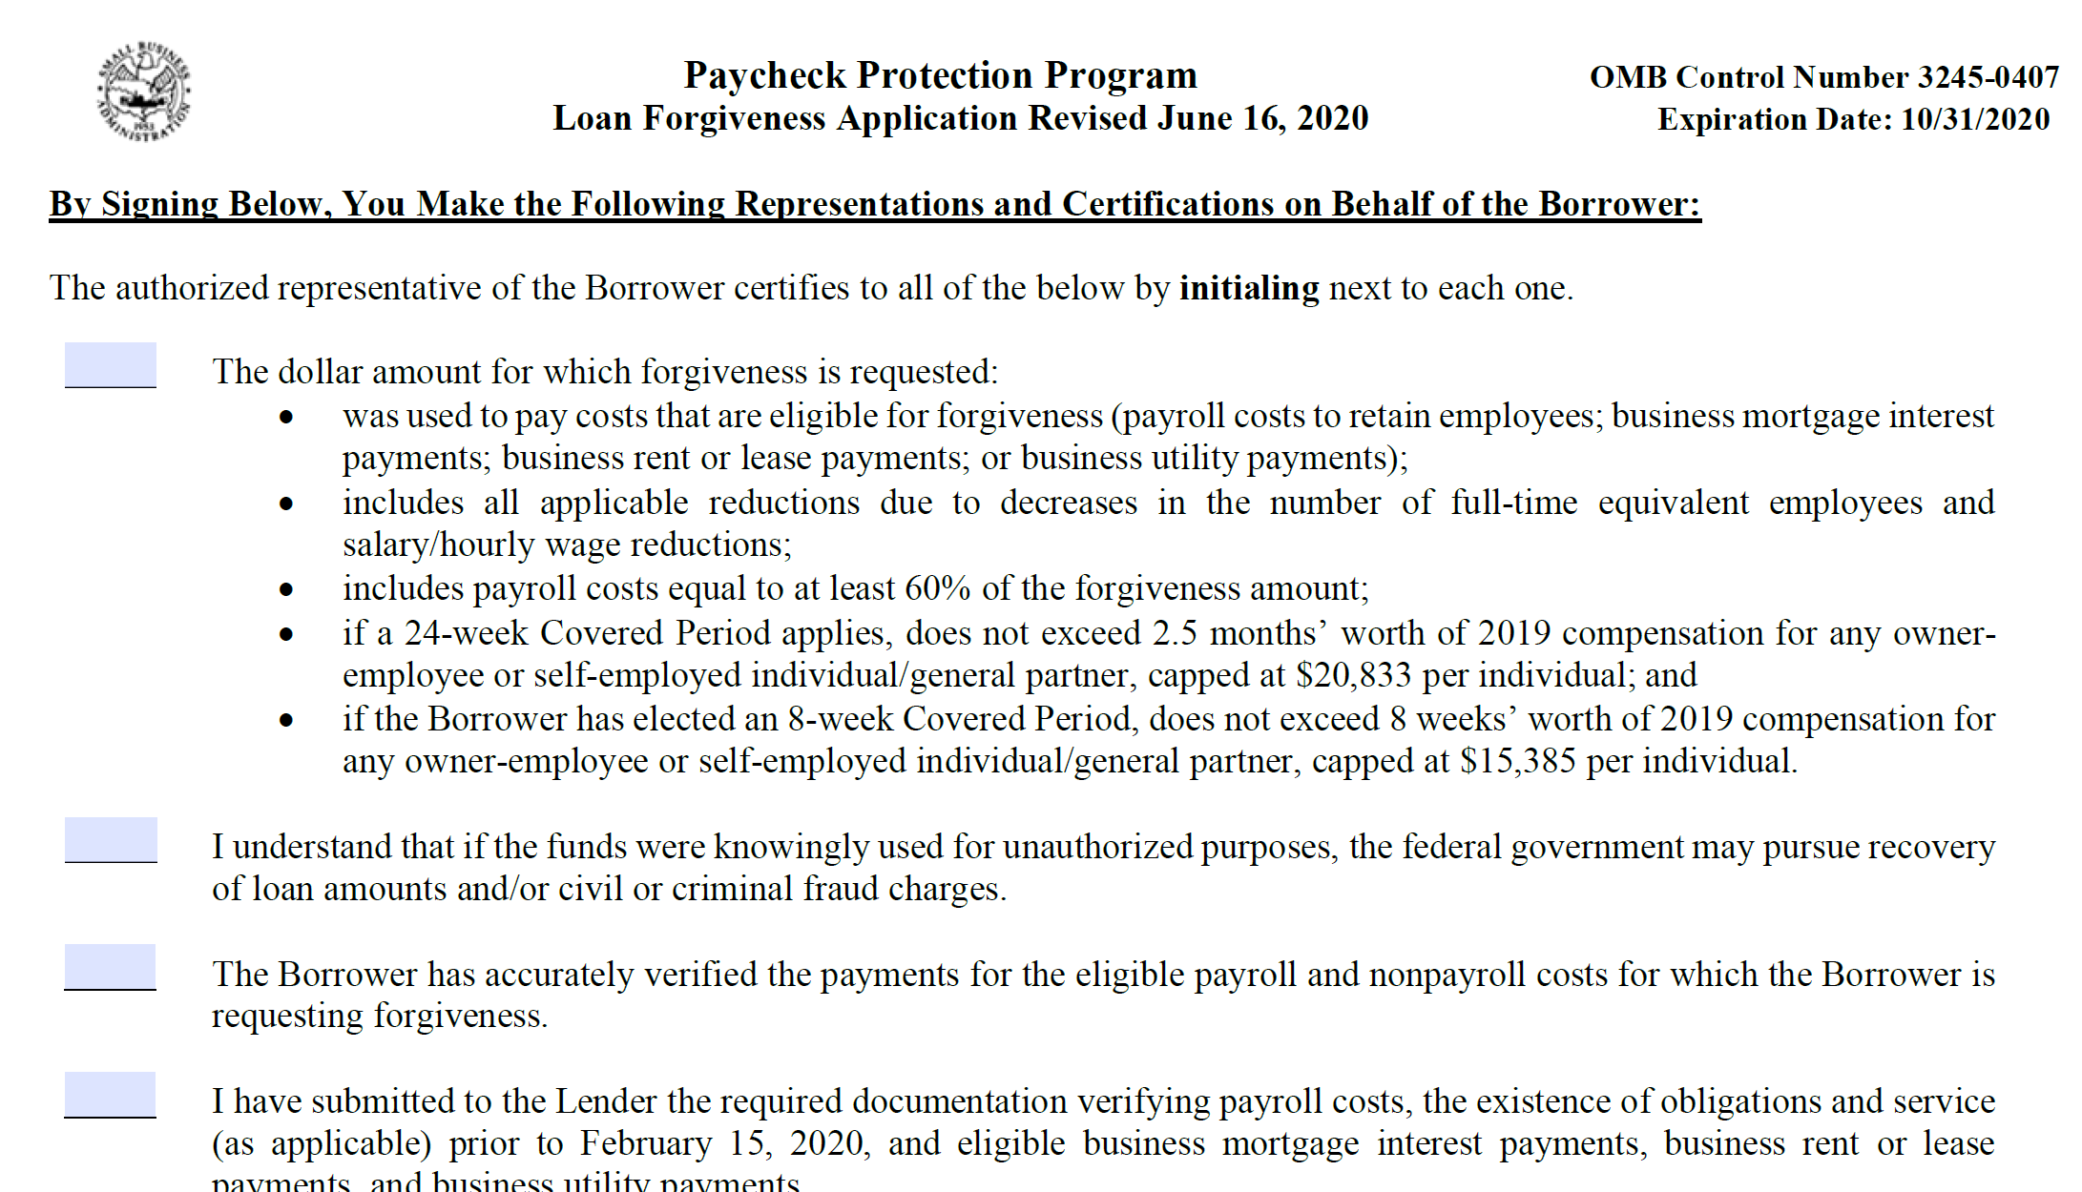
PPP Loan Forgiveness Application

Slide 17
Schedule a Counseling Session
https://www.virginiasbdc.org/locations/
Notes:
Key services of SBDC are counseling, training and information resources
60% of clients are existing firms—gradual shift in past 3 years
50% are women
14% are veterans
26% are minority firms
Areas of counseling and training – financing, marketing, business/strategic planning, start-up
Services (professional, IT, contractors), Retail
Track activities---numbers of companies assiste, but more importantly we ask clients to tell us the results of their SBDC engagement---Jobs created/retained, sales growth, new capital (Debt and equity) and for pre-ventures—did you start a business.

Slide 18
Tips and Considerations
Your lender will make the decision concerning what is eligible and what is not eligible for forgiveness. Check with them to find out what documents will be required
Bankerese – most industries have their own unique language. Be sure that you clearly understand what they need for forgiveness and ask questions
The guidelines are a work in process and are subject to change without notice
Watch out for “shall” or “must”. This means you are required to provide whatever follows
Forgiveness is not “all or nothing”
Become familiar with “Covered Period” and “Alternative Payroll Covered Period”
Prepayment of expenses are not eligible
“Safe Harbor” provisions need to be understood
Eligible costs can be paid or incurred
The 60%/40% split between payroll and other eligible expenses remain in effect

Slide 19
Tips and Considerations
Base comparison periods for seasonal employers, either these base periods or a consecutive 12-week period between 5/1/2019 and 9/15/2019
To receive maximum Full-time Equivalent Employees (FTE), of 1.0, employee records must reflect that they worked 40 hours per week.
If an employee was made a written offer to return to work and refused in writing to do so, or if the employee was terminated for cause (with proper documentation), their reduced headcount will not affect forgiveness
If employer could not restore business to a comparable level of activity because of social distancing or other Federal health guidance MAY not effect forgiveness
Tips can be included in forgiven compensation, based on records maintained by the borrower
Funds not forgiven MAY BE converted to a 5-year loan for pre June 5 loans, which is on forbearance for 6 months. This as at the option of the lender.

Slide 20
Tips and Considerations
Congress is considering changes to the EIDL Advance period, but to date they have not passed any additional legislation
Once your application package has been received by your lender, they have up to 60 days to determine the amount of forgiveness, and the SBA has an additional 90 days to review the lender’s recommendation
Keep detailed documentation including bank statements, invoices, bills, payroll tax filings, completion of the Certification form included in the Forgiveness Application
Any other documents required by your lender and/or the SBA
Retain these records for a minimum of 6 years
Check with your back to see if they are accepting forgiveness applications through their portals.

